Slide 1


Classifier-Driven Prompt Routing
for Complex Temporal Reasoning on TRAM
Southwest Jiaotong University - Leeds University
Presenter: Nie Wenhao
Supervisor: Jia Zhen

Slide 2
CONTENTS
01
02
03
04
05
Research Background
Method Design
Experimental Validation
Error Analysis
Conclusion
Why temporal reasoning requires task-aware prompting
Classifier-driven routing and low-confidence fallback
Evaluation protocol, workflows, and main results
Post-normalization bottlenecks and validity boundaries
Main findings and future work
Classifier-Driven Prompt Routing for Complex Temporal Reasoning on TRAM
01

Slide 3
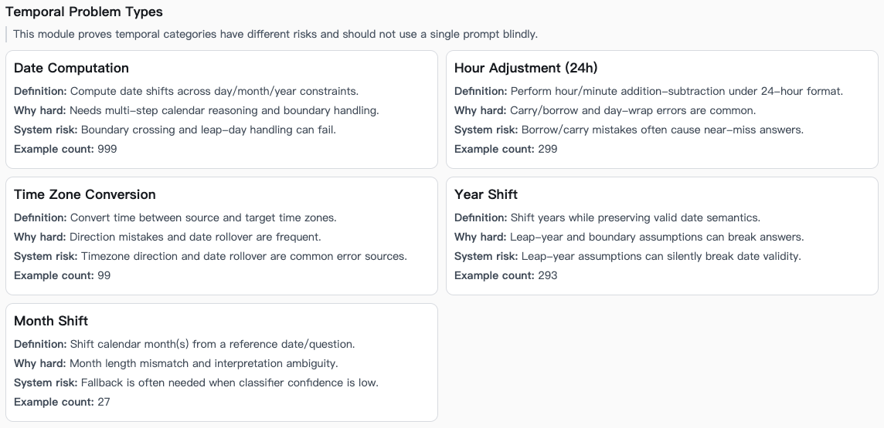
Research Background
Method Design
Experimental Validation
Error Analysis
Conclusion
Motivation: Temporal Reasoning Is Not a Single Skill
• Real-world temporal QA combines language understanding with stable symbolic operations.
• TRAM covers heterogeneous phenomena such as ordering, arithmetic, duration, frequency, and time-zone conversion.
• A single universal prompt is unlikely to be equally effective across all temporal subskills.
• The central question: can a lightweight external router improve end-to-end accuracy without retraining the LLM?
1,600
400
1.0
Workflow outputs evaluated under v1.1
Frozen evaluation slice
LLM calls per query
Classifier-Driven Prompt Routing for Complex Temporal Reasoning on TRAM
02

Slide 4
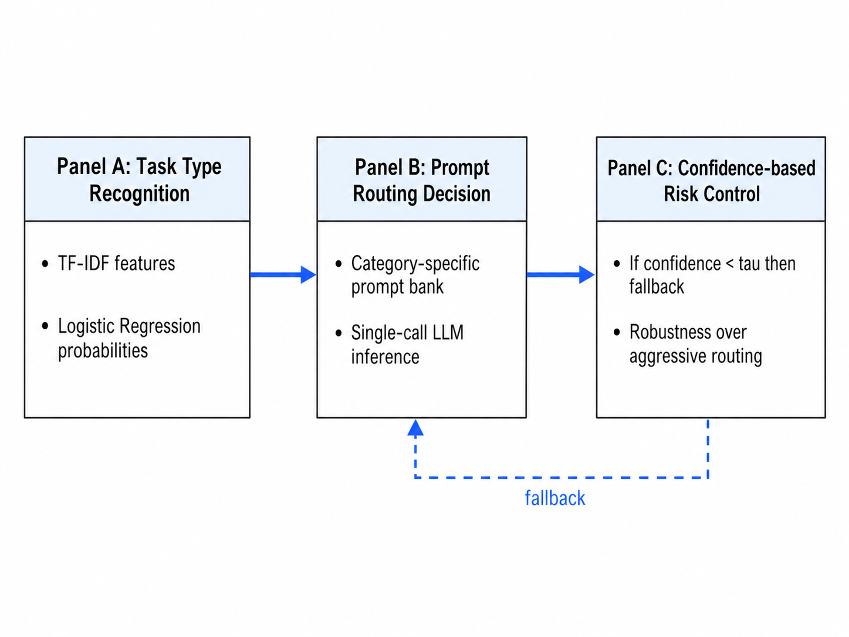
Research Background
Method Design
Experimental Validation
Error Analysis
Conclusion
Research Question and Thesis Claim
Research question
Can a lightweight classifier identify the temporal reasoning type, route the question to a category-specific prompt, and use fallback on low-confidence cases to improve final QA accuracy?
Thesis claim
• Routing is useful because temporal tasks are structurally heterogeneous.
• Fallback is useful because classifier confidence can act as a risk signal.
• Evaluation normalization is necessary to separate genuine reasoning errors from answer-format artifacts.
Classifier-Driven Prompt Routing for Complex Temporal Reasoning on TRAM
03

Slide 5
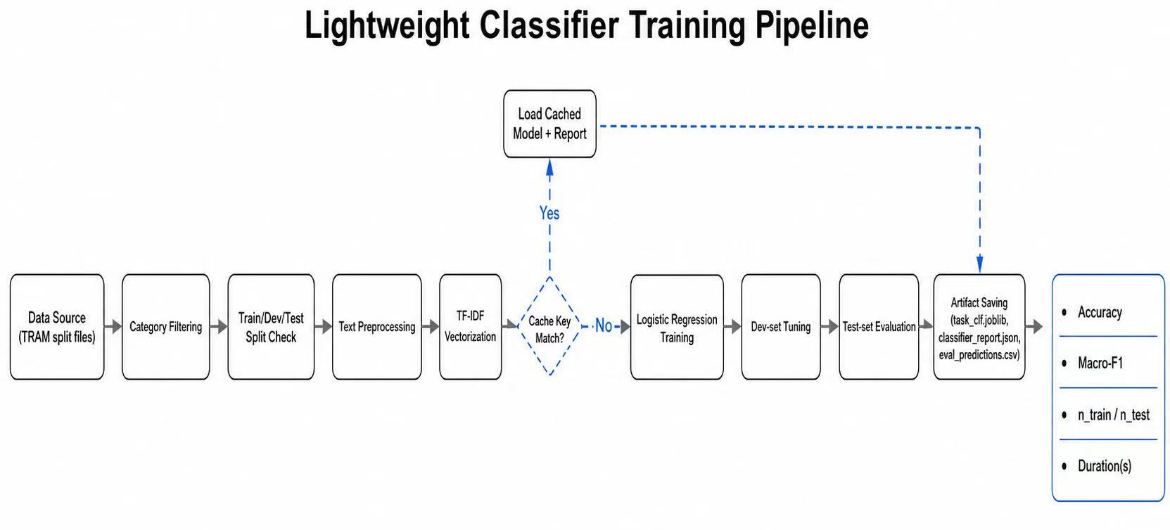
Research Background
Method Design
Experimental Validation
Error Analysis
Conclusion
Contributions
1. Classifier-driven routing
A TF-IDF + Logistic Regression classifier predicts task type probabilities and routes each query to a category-specific prompt.
2. Auditable evaluation normalization
3. Corrected error-surface diagnosis
Ruleset v1.1 performs category-sensitive equivalence normalization at scoring time while leaving original gold answers unchanged.
The analysis identifies the remaining post-normalization bottlenecks: Date Computation, Time Zone Conversion, and Hour24.
Classifier-Driven Prompt Routing for Complex Temporal Reasoning on TRAM
04

Slide 6
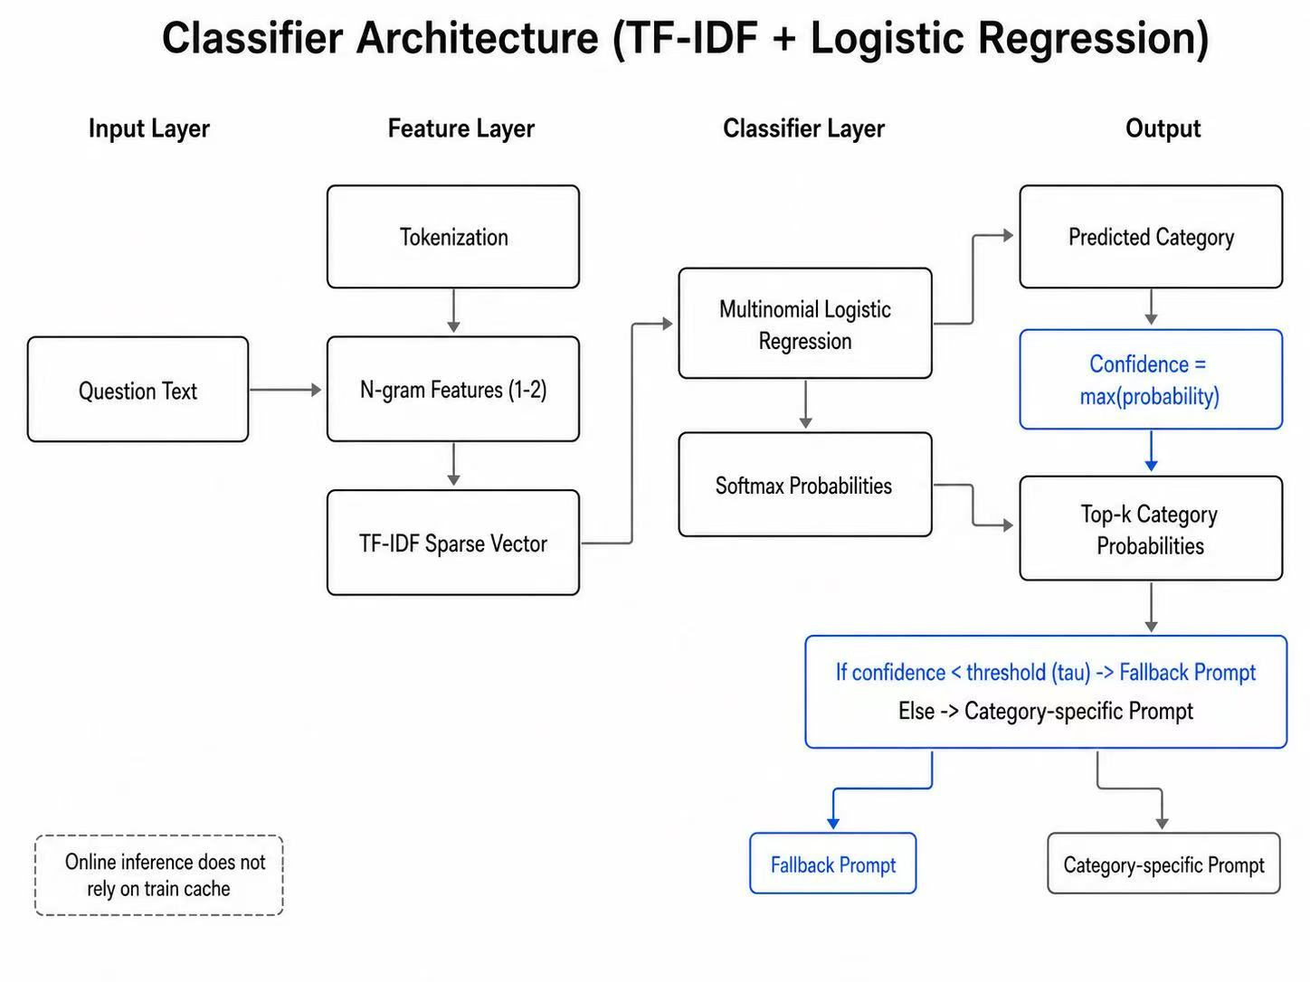
Research Background
Method Design
Experimental Validation
Error Analysis
Conclusion
Classifier Overview
• The router does not modify LLM parameters.
• Confidence is defined as the maximum predicted class probability.
• Fallback targets risk control rather than additional inference calls.
Classifier-Driven Prompt Routing for Complex Temporal Reasoning on TRAM
05

Slide 7
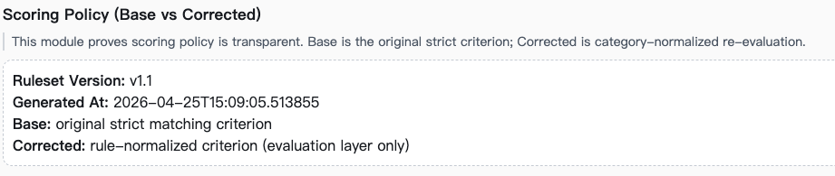
Research Background
Method Design
Experimental Validation
Error Analysis
Conclusion
Evaluation Protocol: ruleset v1.1
Key principle
Normalize equivalent answer formats only at scoring time; do not rewrite the original gold labels.
Base scorer strict string match
ruleset v1.1 category-aware normalization
• The corrected metric is the formal reporting standard.
• Base accuracy remains useful for audit, not for final ranking.
• Corrected gains should be interpreted as measurement correction, not as a new model improvement.
Classifier-Driven Prompt Routing for Complex Temporal Reasoning on TRAM
06

Slide 8
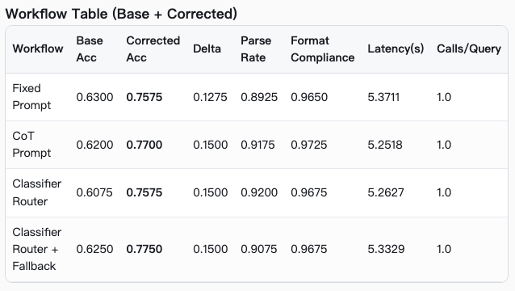
Research Background
Method Design
Experimental Validation
Error Analysis
Conclusion
Main Results: Corrected Accuracy
Corrected accuracy by workflow
0.7750
+0.0175
Fixed
0.7575
Strongest observed workflow
Gain over Router
CoT
0.7700
Router
1.0
5.25-5.37s
0.7575
Calls per query
Latency range
Router + FB
0.7750
• Router + Fallback is the strongest observed workflow under the corrected metric.
• The improvement does not come from increasing external LLM calls.
• CoT remains a strong baseline, but it does not dominate the routed workflow.
Classifier-Driven Prompt Routing for Complex Temporal Reasoning on TRAM
07

Slide 9
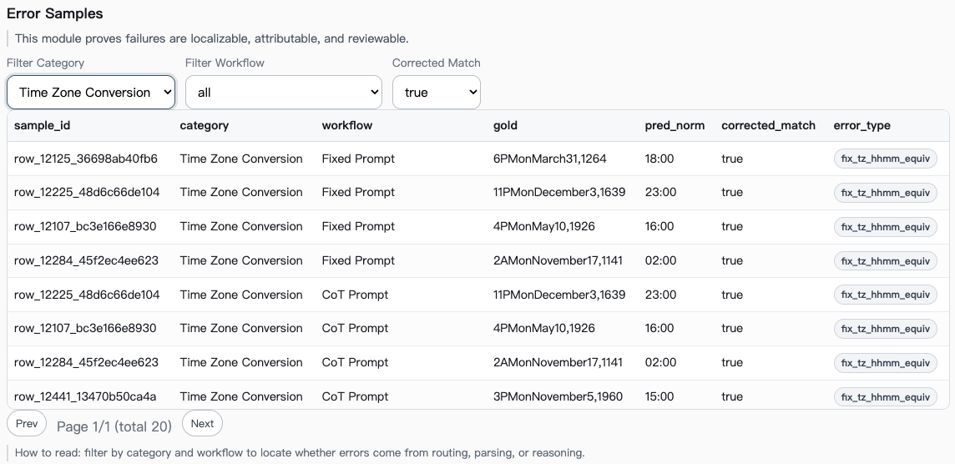
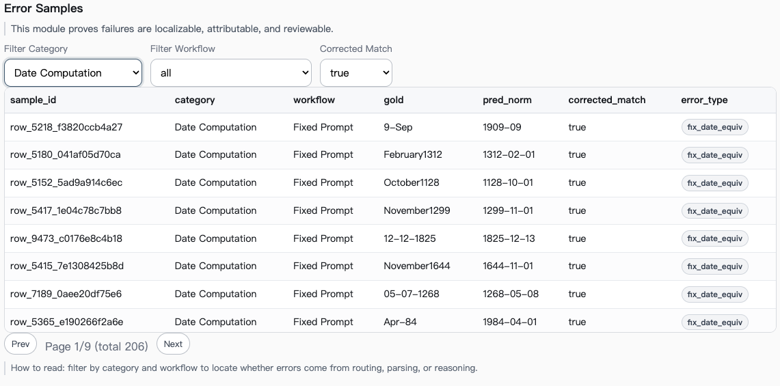
Research Background
Method Design
Experimental Validation
Error Analysis
Conclusion
Base vs Corrected: What Changed?
Interpretive boundary
Workflow | Base | Corrected | Delta
Fixed Prompt | 0.6300 | 0.7575 | +0.1275
CoT Prompt | 0.6200 | 0.7700 | +0.1500
Classifier Router | 0.6075 | 0.7575 | +0.1500
Router + Fallback | 0.6250 | 0.7750 | +0.1500
• Formal comparison should use corrected results.
• Base results remain useful for auditing scorer behavior.
• A corrected oracle has not yet been computed, so headroom remains unquantified.
Classifier-Driven Prompt Routing for Complex Temporal Reasoning on TRAM
08

Slide 10
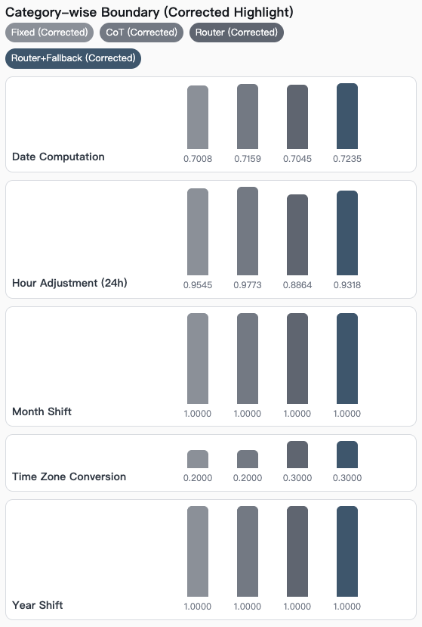
Research Background
Method Design
Experimental Validation
Error Analysis
Conclusion
Category-Level Findings
Category | Fixed | CoT | Router | Router + FB
Date Computation | 0.5265 → 0.7008 | 0.5076 → 0.7159 | 0.5038 → 0.7045 | 0.5265 → 0.7235
Hour Adjustment (24h) | 0.9545 → 0.9545 | 0.9773 → 0.9773 | 0.8864 → 0.8864 | 0.9318 → 0.9318
Time Zone Conversion | 0.0000 → 0.2000 | 0.0000 → 0.2000 | 0.0000 → 0.3000 | 0.0000 → 0.3000
Year Shift | 1.0000 → 1.0000 | 1.0000 → 1.0000 | 1.0000 → 1.0000 | 1.0000 → 1.0000
• Date Computation receives the largest normalization recovery but remains substantially below Hour24 and Year Shift.
• Time Zone Conversion improves from zero under the base scorer but remains difficult after correction.
• Year Shift is near ceiling in this slice; Hour24 errors appear to reflect real carry/borrow reasoning rather than formatting.
Classifier-Driven Prompt Routing for Complex Temporal Reasoning on TRAM
09

Slide 11
Research Background
Method Design
Experimental Validation
Error Analysis
Conclusion
Remaining Corrected Errors
Relative share of remaining corrected errors
376
305
Date Computation
305
Total remaining corrected errors
Date Computation errors
Time Zone Conversion
60
60
11
Hour24
11
Time Zone Conversion errors
Hour24 errors
• Date Computation is the dominant post-normalization bottleneck.
• TZ errors cluster around one-hour offsets and minute mismatches.
• Hour24 failures indicate carry/borrow state inconsistency.
Classifier-Driven Prompt Routing for Complex Temporal Reasoning on TRAM
10

Slide 12
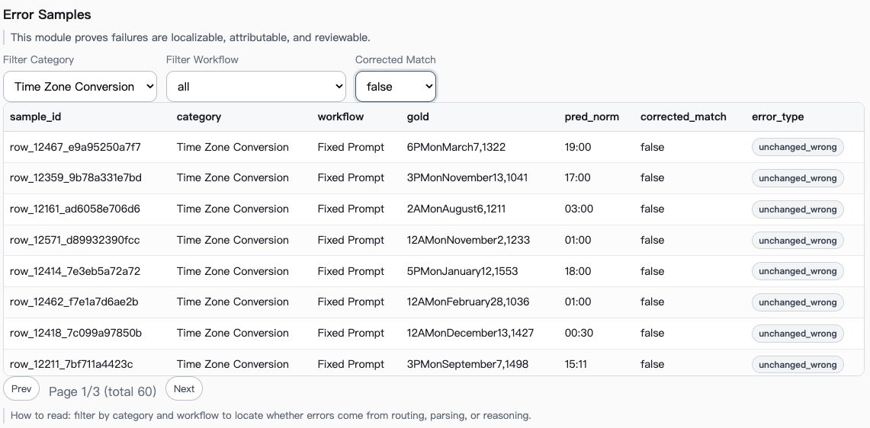
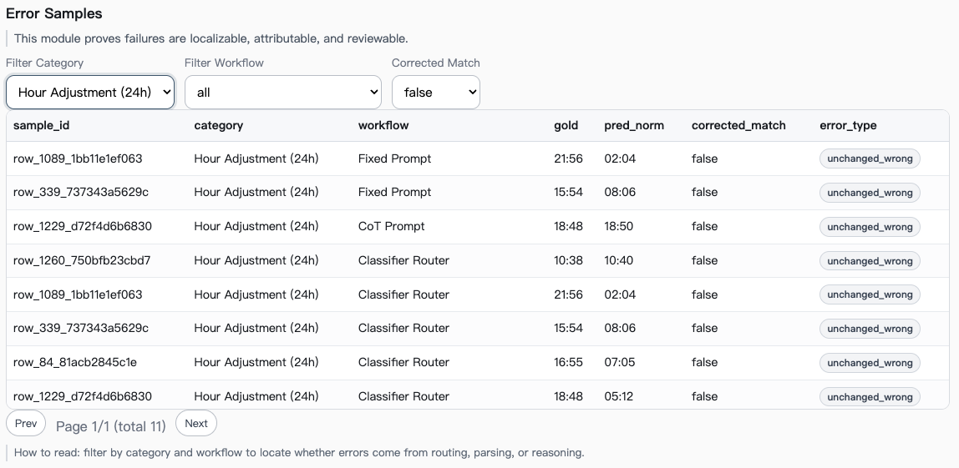
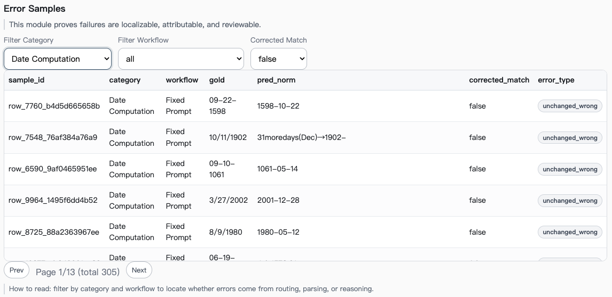
Research Background
Method Design
Experimental Validation
Error Analysis
Conclusion

Slide 13
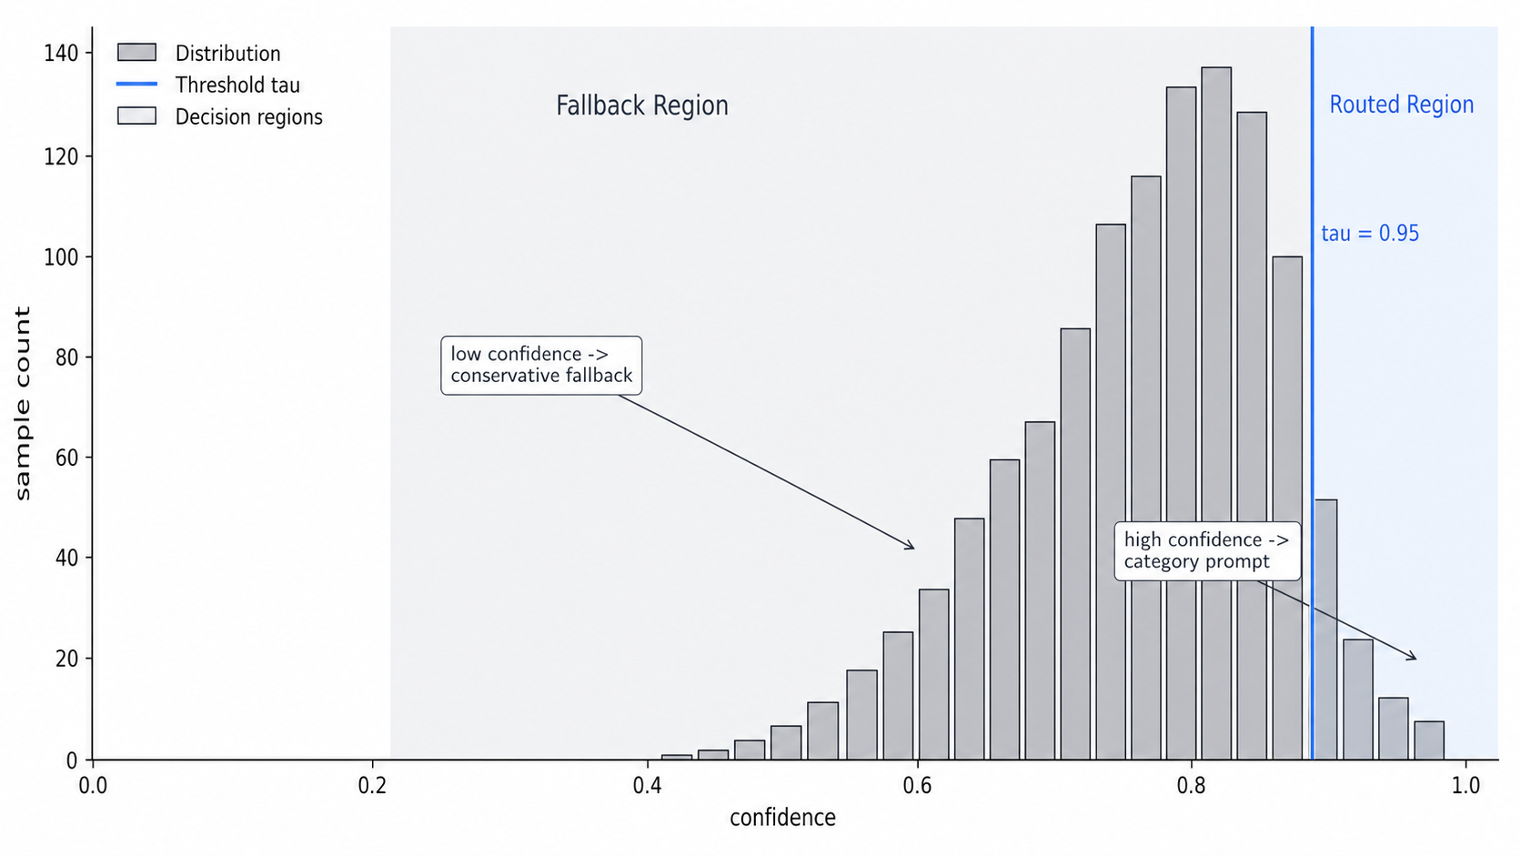
Research Background
Method Design
Experimental Validation
Error Analysis
Conclusion
Why Fallback Helps
Fallback as selective risk control
• The maximum predicted class probability is used as a confidence score.
• When confidence is low, the system avoids a potentially harmful category-specific prompt.
• This mechanism improves robustness without adding additional LLM calls.
• The empirical pattern is consistent with the broader selective prediction framing.
High confidence → route
Low confidence → fallback
Classifier-Driven Prompt Routing for Complex Temporal Reasoning on TRAM
11

Slide 14
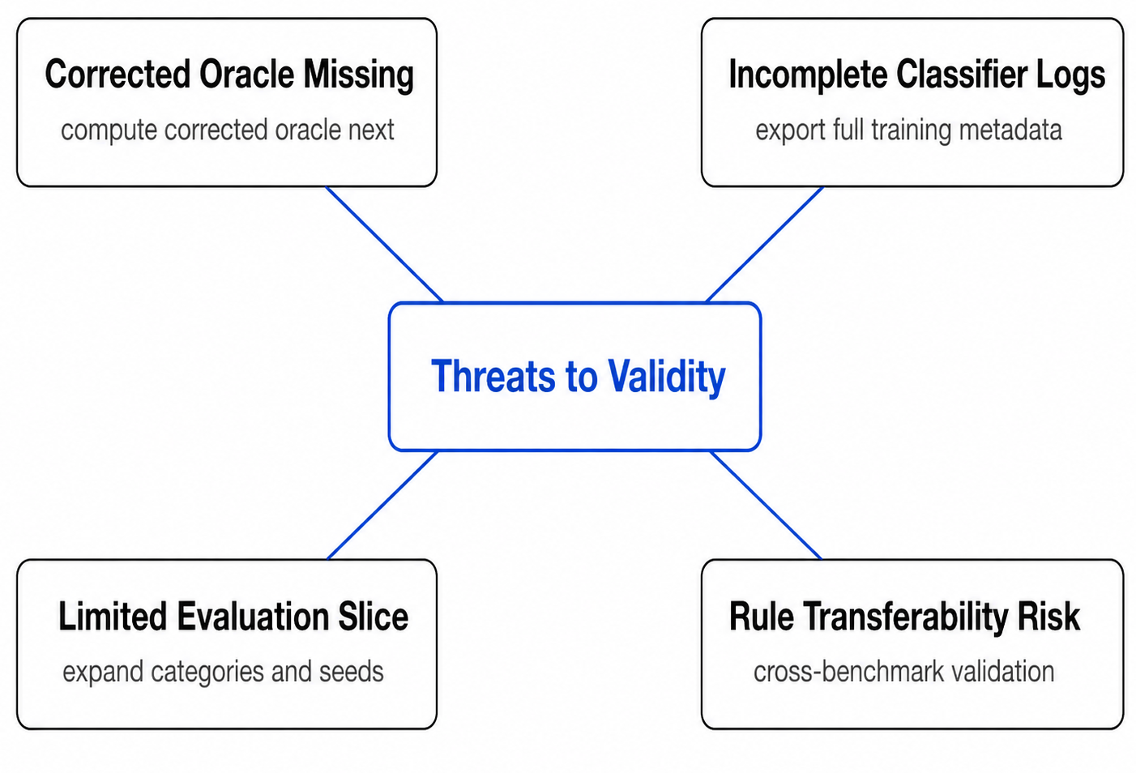
Research Background
Method Design
Experimental Validation
Error Analysis
Conclusion
Limitations
• Classifier training logs are incomplete
– Macro-F1, final threshold tau, and final hyperparameters should be exported.
• Evaluation uses a 400-question frozen slice
– Wilson intervals are reported, but broader test evaluation would strengthen inference.
• ruleset v1.1 is manually engineered
– Its transferability to open-answer benchmarks remains limited.
Classifier-Driven Prompt Routing for Complex Temporal Reasoning on TRAM
12

Slide 15
Research Background
Method Design
Experimental Validation
Error Analysis
Conclusion
Future Work: Follow the Corrected Error Surface
Date prompt bank
Target cross-month/year steps, leap-year checks, and multi-field updates.
305 errors
TZ directional constraints
Make direction, UTC conversion, and half-hour offsets explicit.
60 errors
Hour24 carry/borrow prompts
Force minute-first calculation, then borrow/carry, then hour update.
11 errors
Classifier-Driven Prompt Routing for Complex Temporal Reasoning on TRAM
13

Slide 16
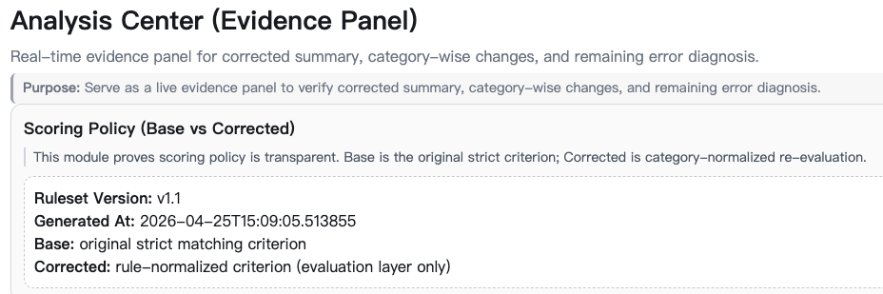
z
Research Background
Method Design
Experimental Validation
Error Analysis
Conclusion
Conclusion
Three takeaways
• Complex temporal reasoning is heterogeneous enough to justify classifier-driven prompt routing.
• Under ruleset v1.1, Router + Fallback is the strongest observed workflow with no extra LLM call count.
• After format artifacts are removed, the research agenda becomes clearer: Date, TZ, and Hour24 are the main structural bottlenecks.
Core message: this work is not only a routing method, but also a cleaner measurement framework for temporal reasoning.
Classifier-Driven Prompt Routing for Complex Temporal Reasoning on TRAM
14

Slide 17
REFERENCES
Selected References
Wang, Y. & Zhao, Y. (2024). TRAM: Benchmarking Temporal Reasoning for Large Language Models.
Chu, Z. et al. (2024). TIMEBENCH: A Comprehensive Evaluation of Temporal Reasoning Abilities in LLMs.
Wei, J. et al. (2022). Chain-of-Thought Prompting Elicits Reasoning in Large Language Models.
Kojima, T. et al. (2022). Large Language Models are Zero-Shot Reasoners.
Geifman, Y. & El-Yaniv, R. (2017). Selective Classification for Deep Neural Networks.
Guo, C. et al. (2017). On Calibration of Modern Neural Networks.
Manning, C. D., Raghavan, P. & Schütze, H. (2008). Introduction to Information Retrieval.
Fan, R.-E. et al. (2008). LIBLINEAR: A Library for Large Linear Classification.
Classifier-Driven Prompt Routing for Complex Temporal Reasoning on TRAM
15

